Slide 1
Week-01 Day-04 Conditional statements and Loops
By: Engr. Asif ali

Slide 2
Contents
If statement
If-else statement
For loop
While loop
Break
Continue
Activities
Tasks

Slide 3
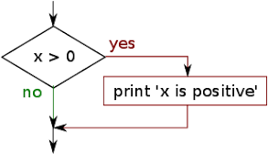
Conditional Execution if statement

Slide 4
Conditional Statement
Conditon will be checked if the condition is true then body of the if statement will be executed otherwise it will not be executed.

Slide 5
Activity-01
x = 5
if x>5:
print(“It is positive number”)

Slide 6
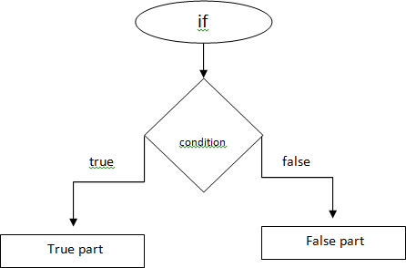
if-else statement

Slide 7
Activity-02
x = 5 if x>0:
print("Number is positive")
else:
print("Number is negative")

Slide 8
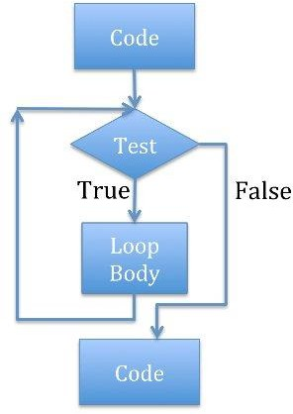
Iterations

Slide 9
Iterations
Control statement: In this,code is first tested.If the conditon is true then code will be executed again and again untill and unless condition becomes false.

Slide 10
for loop
for a in range(1,11):
print(a)

Slide 11
while loop
a = 1
while a<=5: print(a) a=a+1

Slide 12
Activity-03
Write a python program which print number of Pakistan by taking user’s choice.
Enter any number:2 Pakistan
Pakistan

Slide 13
Activity-04 Write a python program which display numbers from 10 to 1
Sample Output:
10
9
8
7
6
5
4
3
2
1

Slide 14
Activity-05 Write a python program which display numbers from 10 to 1 but it should skip 5
Sample Output:
10
9
8
7
6
4
3
2
1

Slide 15
Task-01: Write a python program that display table according to user input.
Sample Output:
Enter any number: 4
4X1=4
4X2=8
4X3=12
4X4=16
4X5=20
.
.
.
4X10=40

Slide 16
Task-02: Write a python program that count sum of even and odd numbers from 1 to 100. Finally display sum separately on the screen.

Slide 17
Task-03: Write a python program that takes input from user and check that the entered number is leap year
Sample Output:
Enter any year: 2004
Enter year 2004 is the leap year

Slide 18
Task-04: Write a python program that takes three input from user and check which number is greater
Sample Output:
Enter any number: 55
Enter any number: 4
Enter any number: 3
55 is greater number

Slide 19
Task-05: Write a python program that display output as given below
Sample Output:
A
AA
AAA
AAAA
AAAAA
AAAAAAA

Slide 20
Task-06: Write a python program that display output as given below
Sample Output:
AAAAA
AAAA
AAA
AA
A

